Slide 1
Create your account
Welcome to
Username
Enter a username
✓
CBR
Email
Enter your email address
✓
Built for citizens, by citizens.
Password
Enter a password
✓
Confirm your password
✓
✓
By signing up, you agree to the terms & conditions
Sign Up
Sign In
Aaron W.
Albert M.

Slide 2
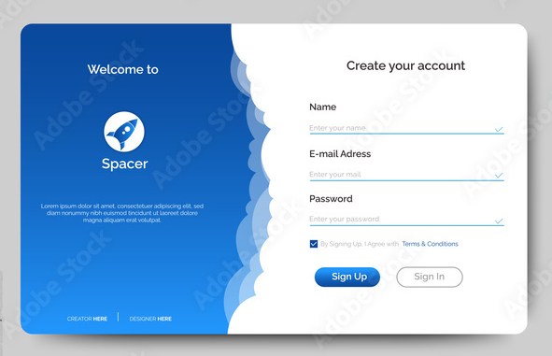








Inspiration for the login screen
Input verification
Welcome text
Sign up and sign in buttons
Names of creators

Slide 3
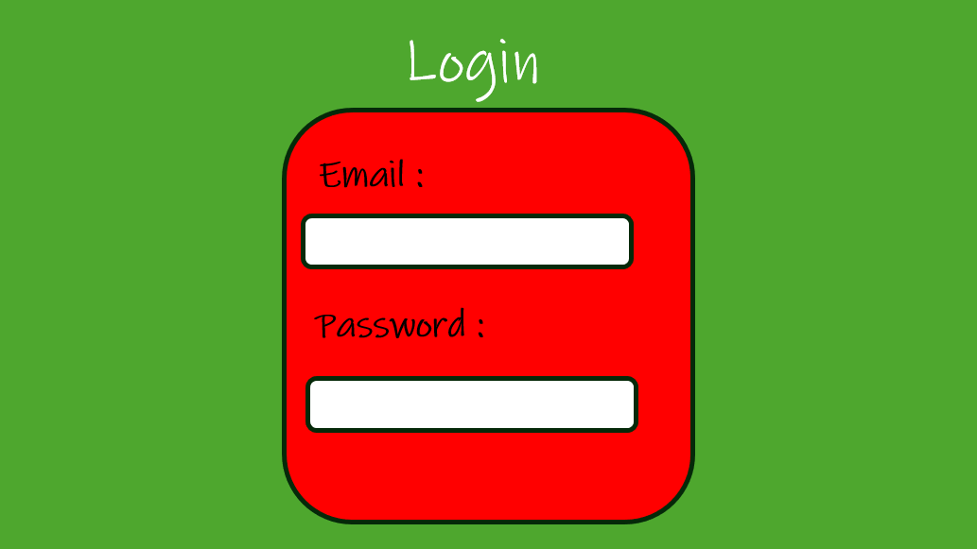
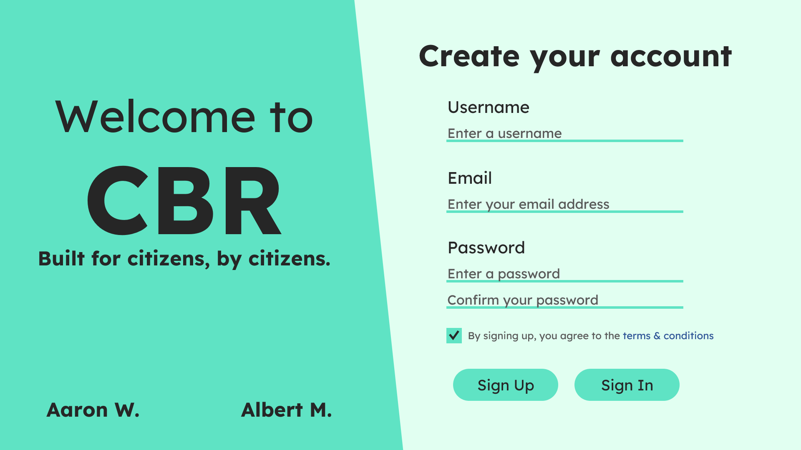
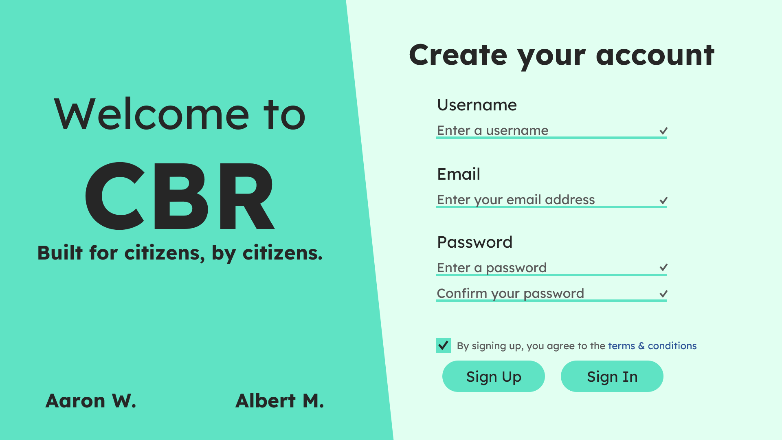
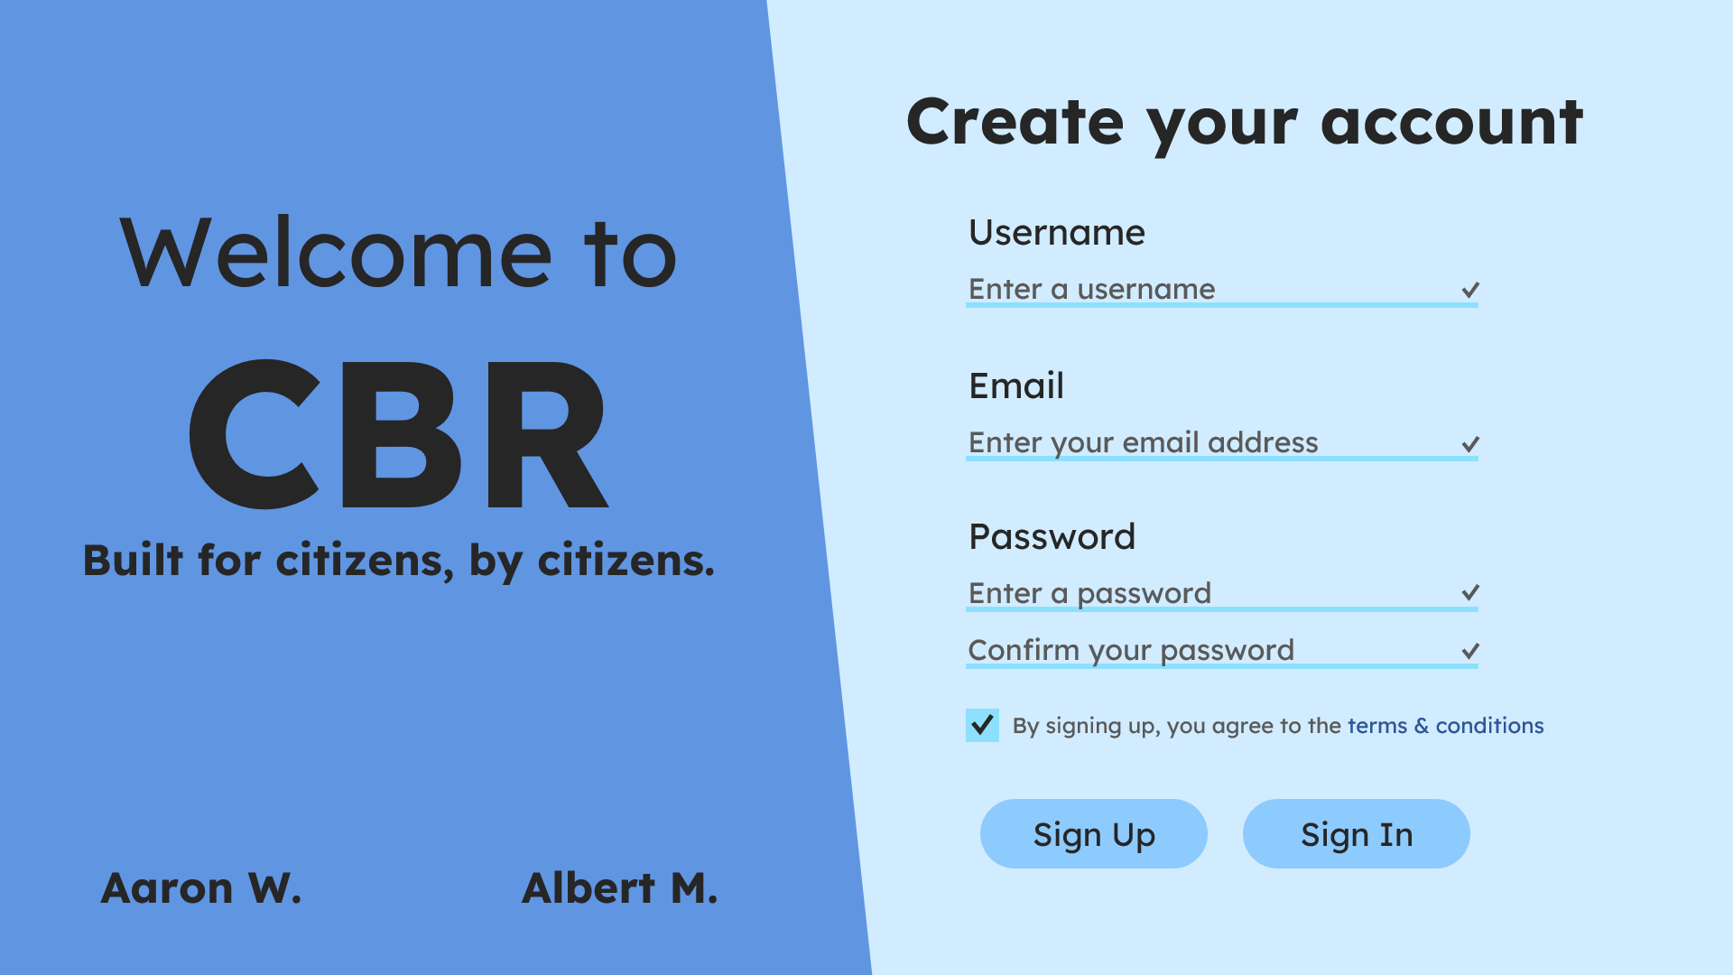
Design Evolution
Random design
First draft
Second draft
Most recent revision

Slide 4
City Bug Reports
Log in
Sign up
Built for citizens,
by citizens.
A free-forever platform to give your neighbors a heads-up when they need one most.
Enter your email address
Get started

Slide 5
Inspiration for the login screen
Input verification
Welcome text
Sign up and sign in buttons
Names of creators

Slide 6
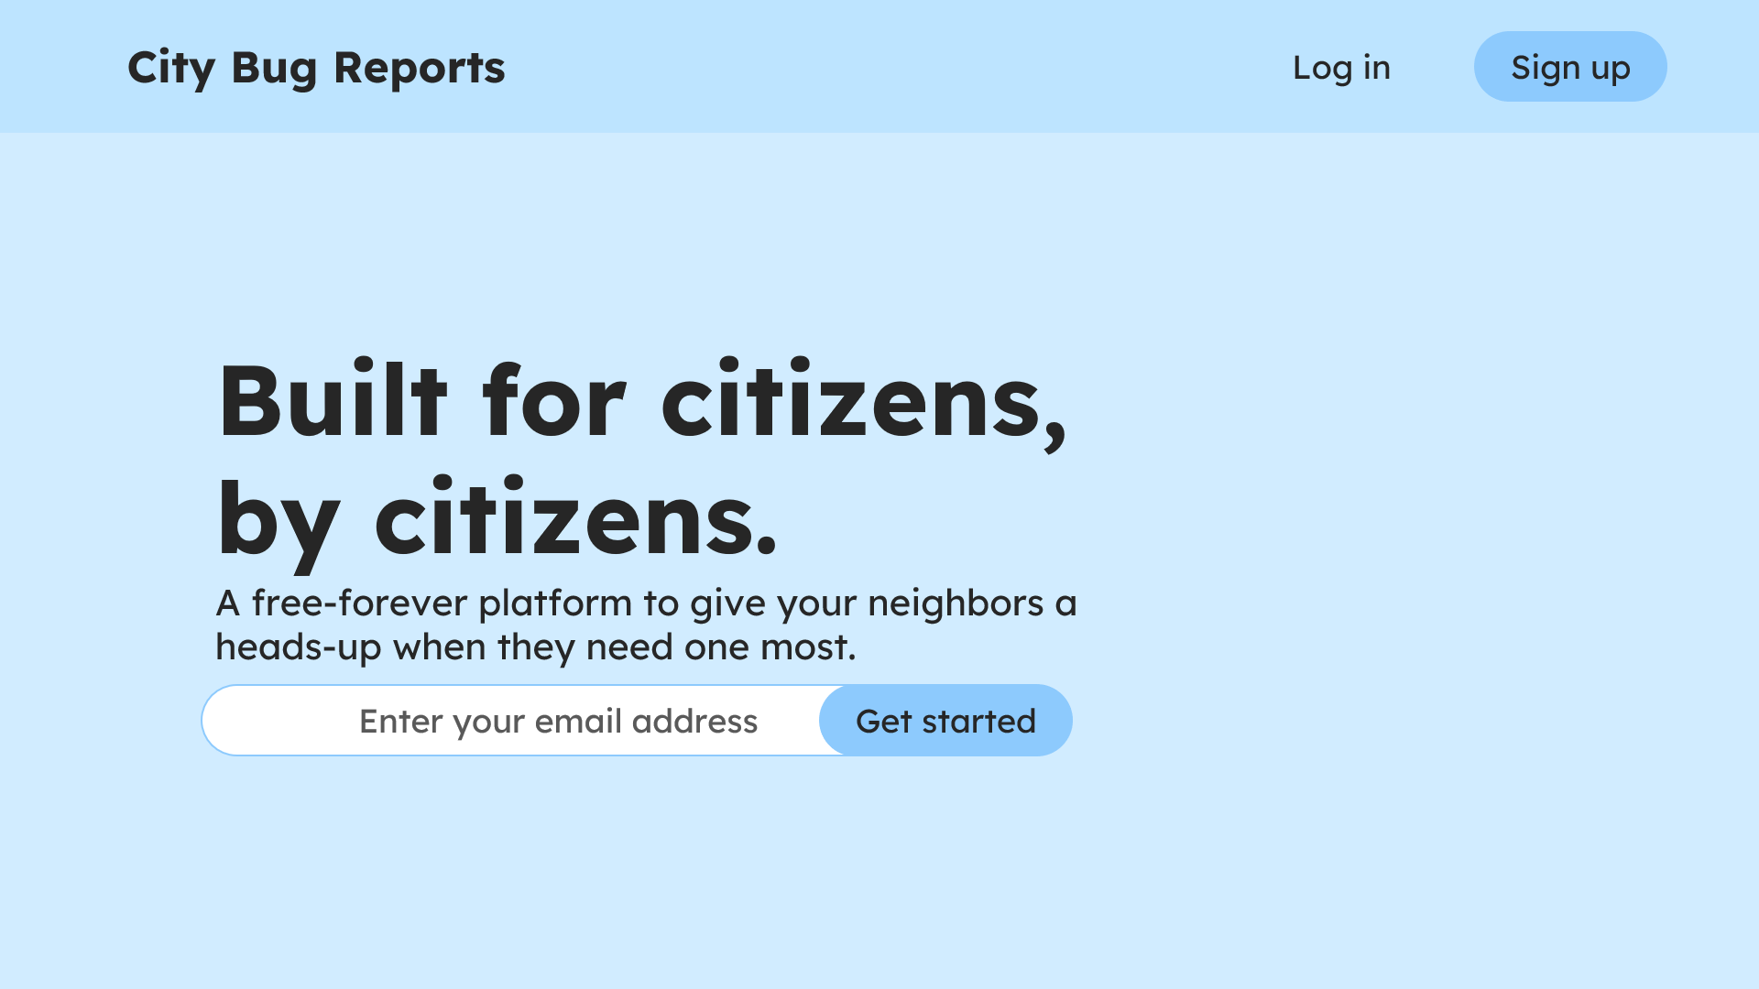
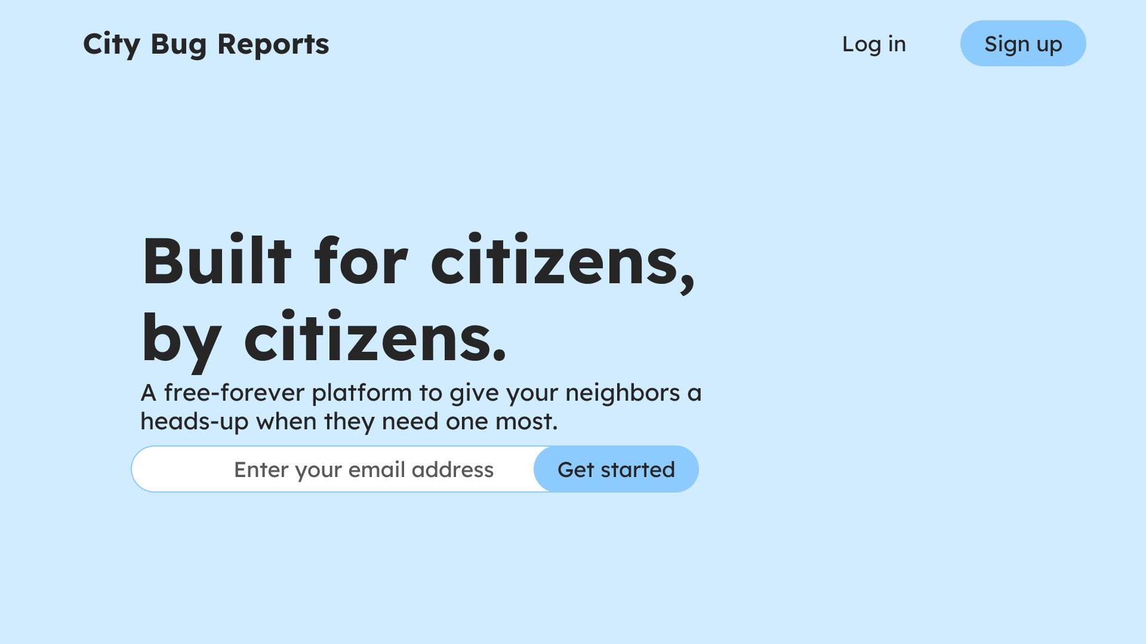

Design Evolution
First Draft
Second draft
Second draft
Most recent revision

